Slide 1
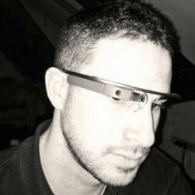
LACE – Project overview
Angel Suarez| Open Universiteit
WAPLA Workshop| 16 September 2016
#laceproject, angel.suarez@ou.nl

Slide 2
Presentation Outline
LACE introduction
  Vision of LACE
  Goals and objectives
  Who we are
WP Activities (WP1 – WP8)
SIG LACE @ SoLAR

Slide 3
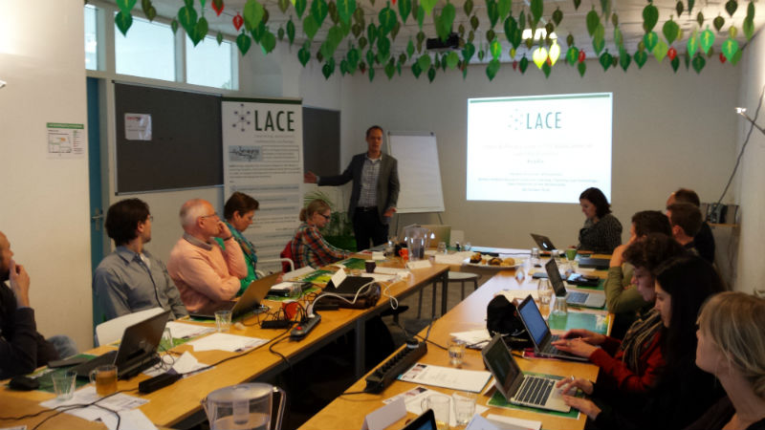
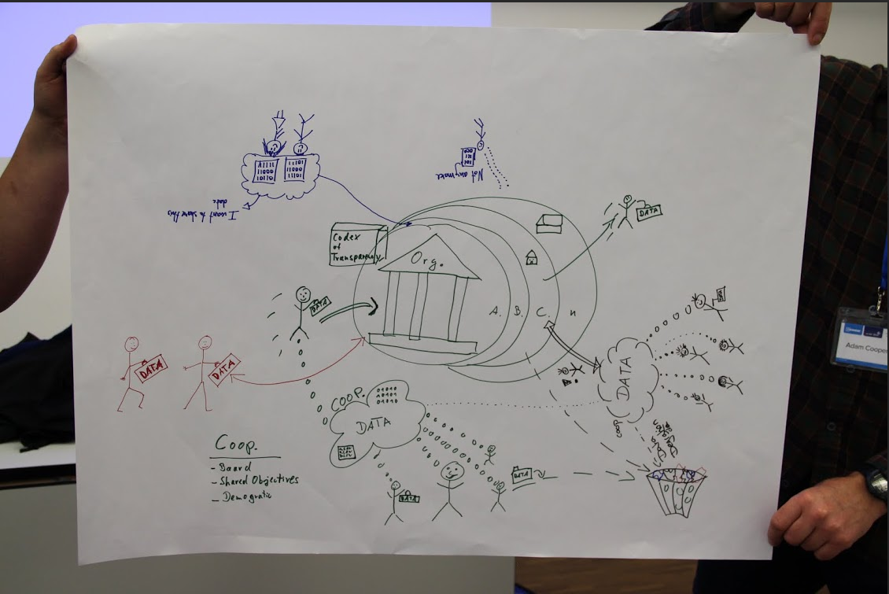
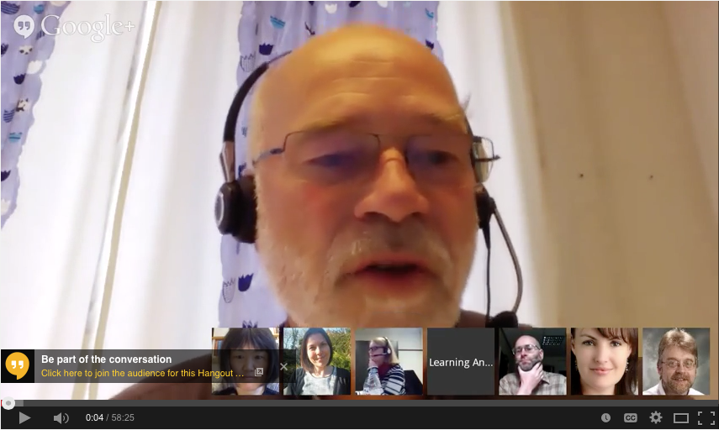
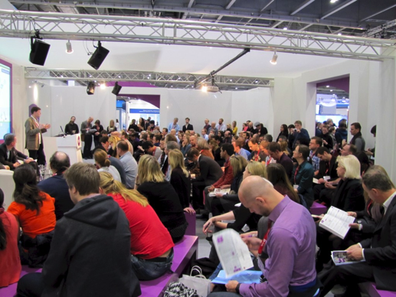
Vision: Knowledge transfer
European support action aimed at integrate communities working on LA from schools, workplace and universities
Community-building through events & communication channels/social media
(cross-disciplinary HE, K12, Workplace)
Organized / Contributed 67 events (tutorials, workshops, conferences, etc.)
Knowledge transfer & best practice
HE
K12
Workplace

Slide 4
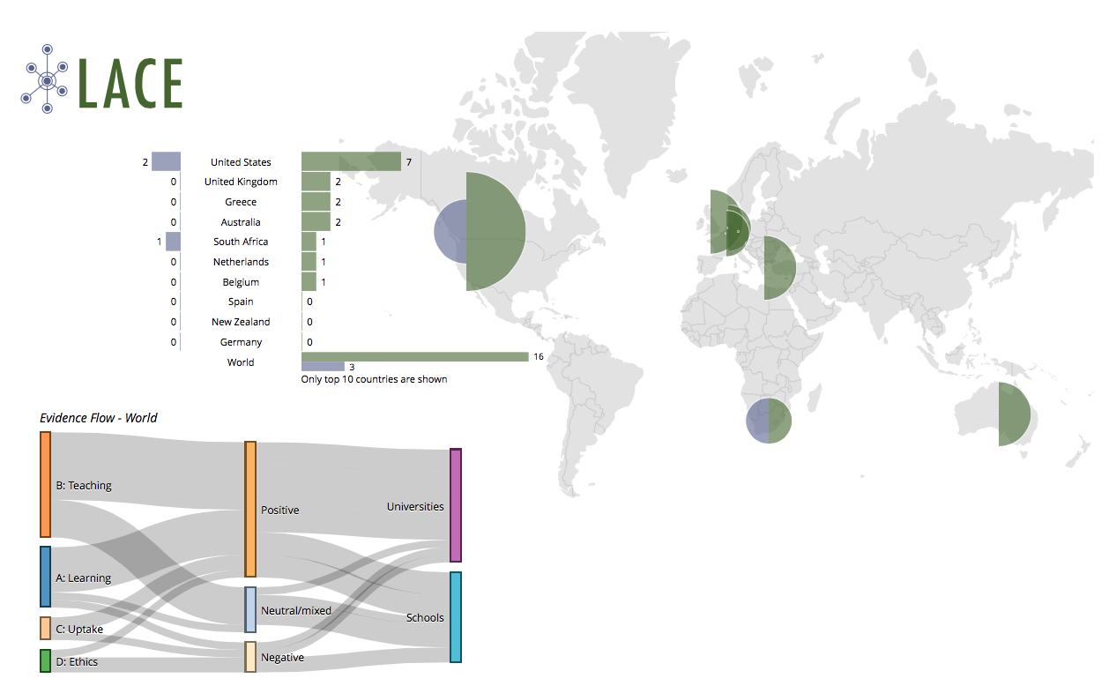
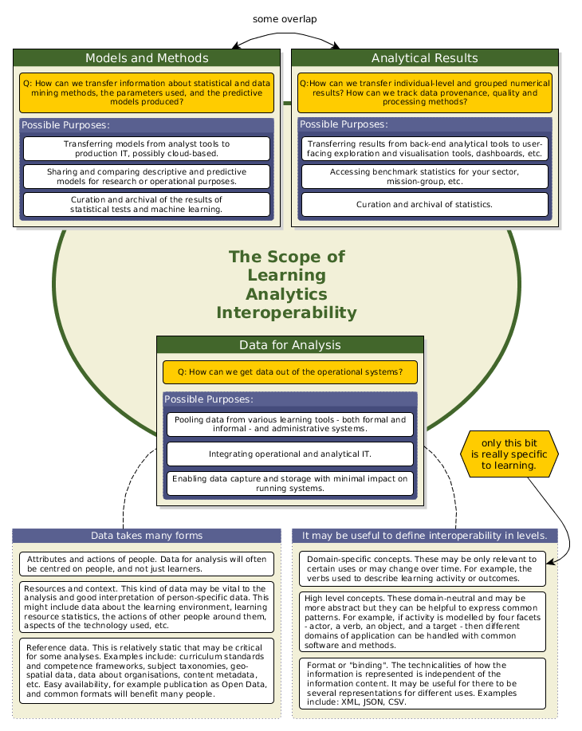
LACE Goals and objectives
Objective 1 – Promote knowledge creation and exchange
Objective 2 – Increase the evidence base (accelerate beneficial uptake of LA)
Objective 3 – Contribute to the definition of future directions (teachers, researchers, policy makers and institutional managers)
Objective 4 – Build consensus on inter-operability and data sharing
EP4LA Workshops
Evidence Hub
Interoperability Studies

Slide 5
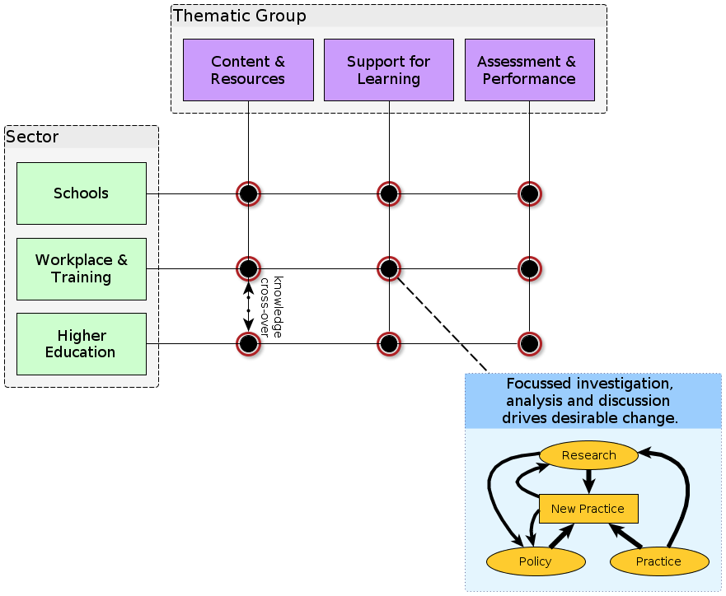
Fulfilling the Vision
Ethical practice
Supporting roll-out
Planning for the future
Research & Policy & Practice
Research:
Visions of the Future study
Workshops on the Visions
Policy:
Brussels Policy development
New Practice:
Feed-through to other LA projects - LAEP, SHEILA, LS4U
Research & Policy & Practice
Research & Policy & Practice
Research & Policy & Practice
Research:
Interoperability
xAPI profiles
Policy:
LAW Manifesto & Profile
LACE Reviews
New Practice:
xAPI standardisation
Research:
EP4LA workshops
Policy:
JLA SI EP4LA
LACE review
New Practice:
DELICATE checklist
Project: Lea’s Box, SHEILA, LAEP
Research:
Evidence Hub, EFLA Framework
Policy:
SoLAR Flare Events
Annual meeting @ BETT
New Practice:
LAK16 & SoLAR, Apereo collaboration

Slide 6
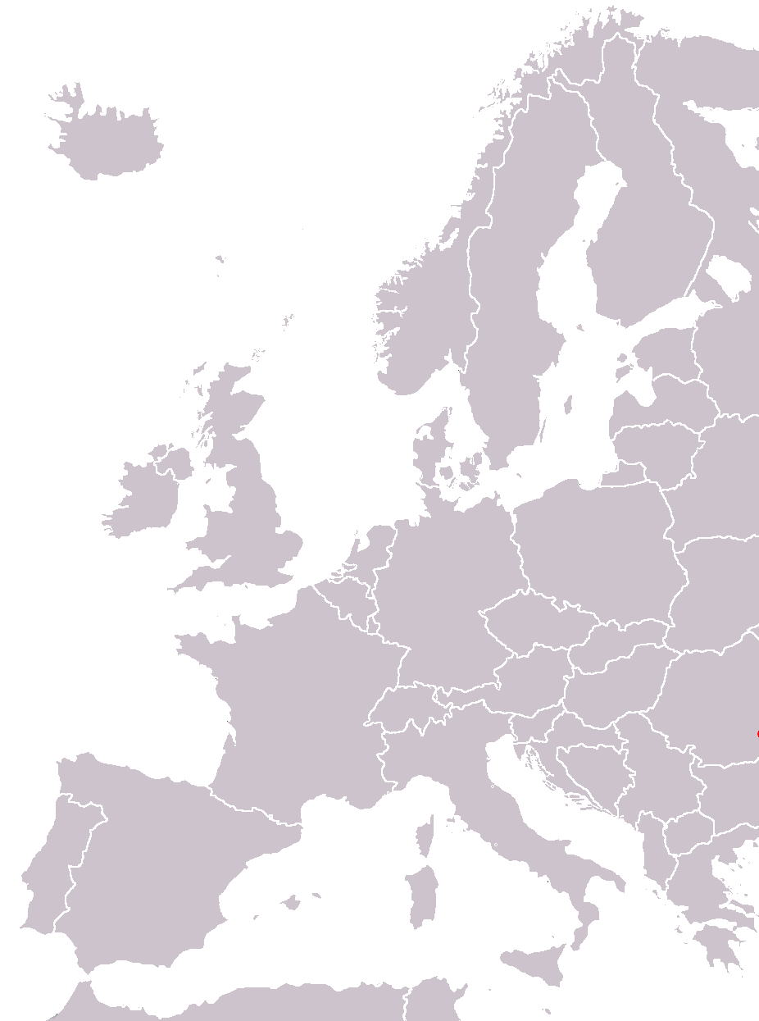




































Who we are (80 Ass. Partners)
LACE Network
LACE Consortium

Slide 7
WP – Activities
(WP1 – WP8)

Slide 8
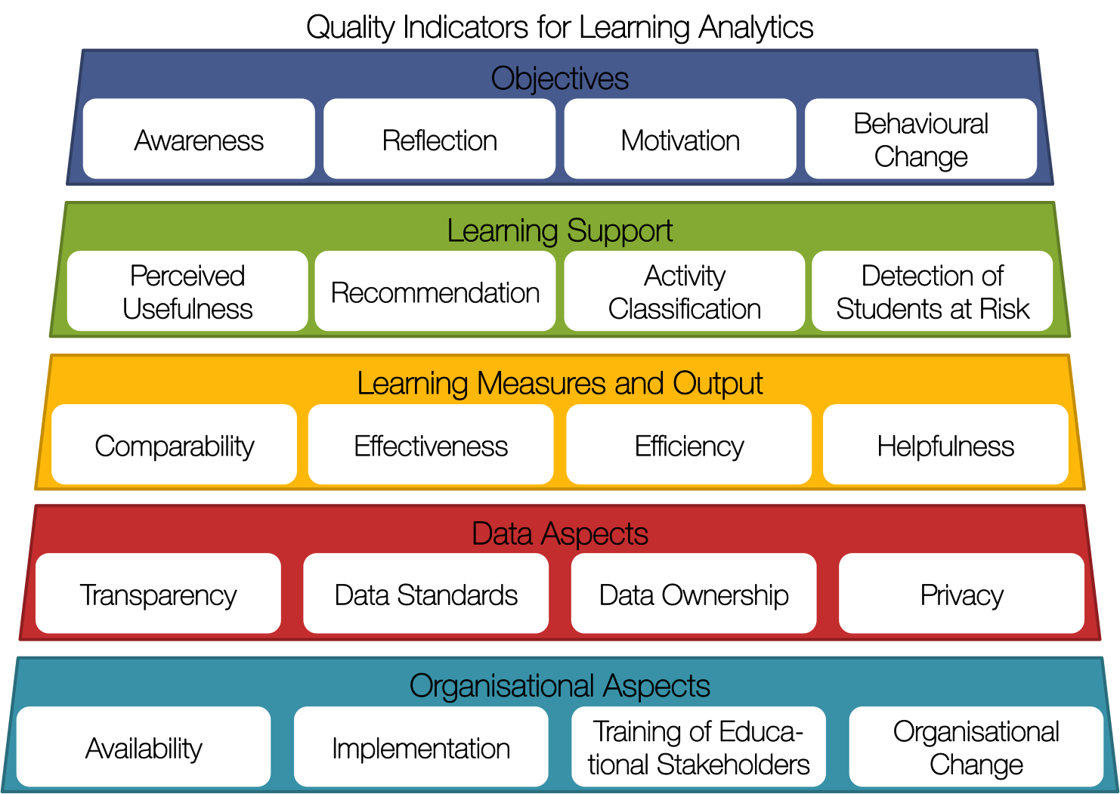
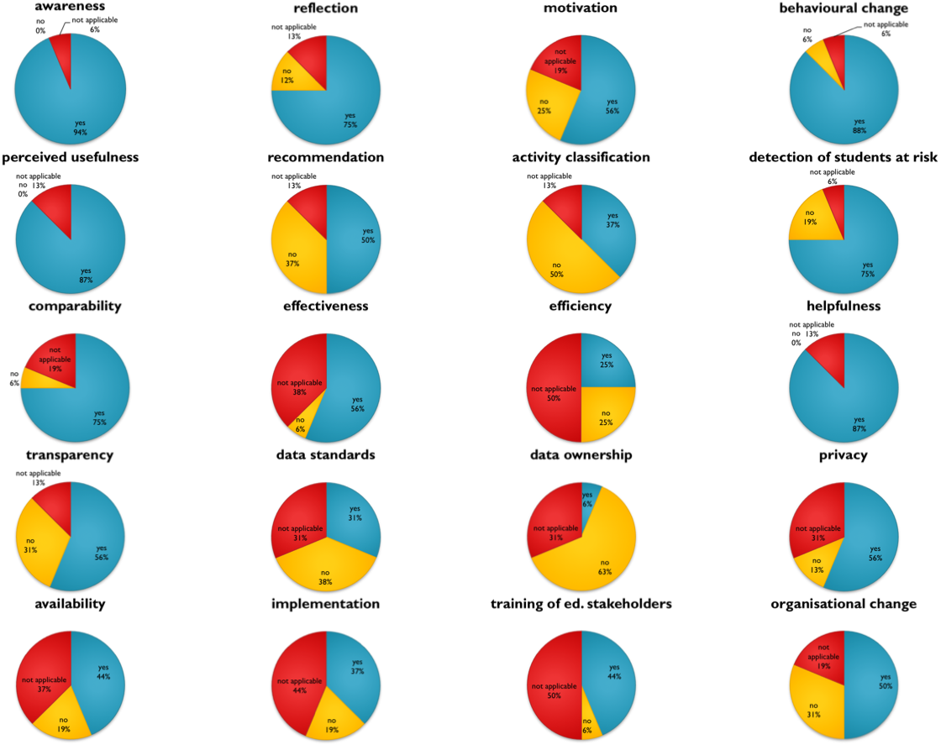
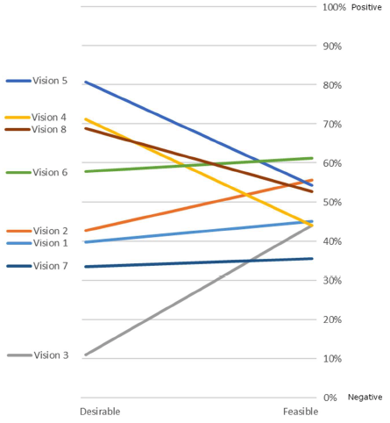
WP3: Cross Domain Studies
EFLA Framework
Available at laceproject.eu
Evaluation support
Vision of the Future
Available at laceproject.eu

Slide 9
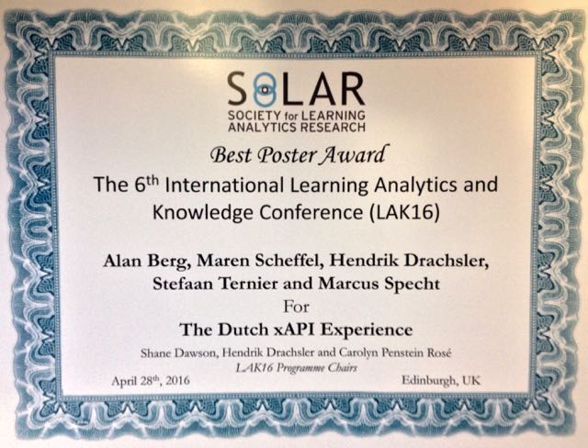
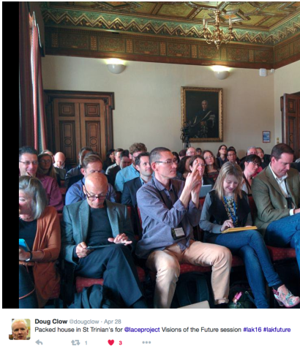
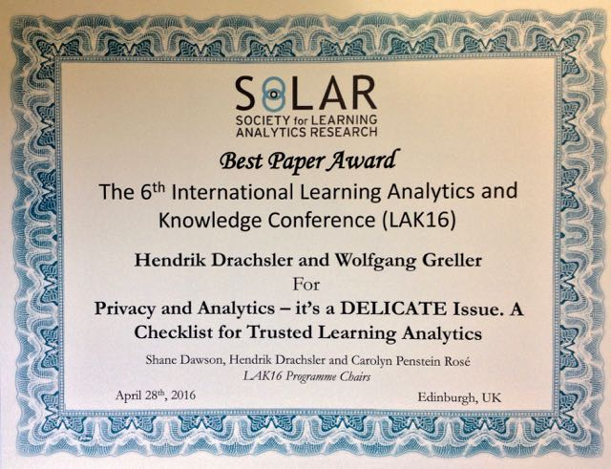
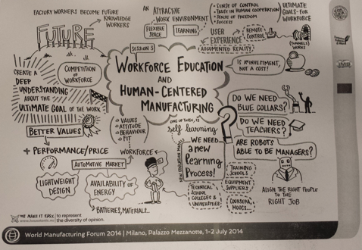
Sector Activities: WP4, 5, 6
LACE events
(19/67/89– 700/3200/4670 contacts)
LinkedIn members (213/343/508)
Twitter (170/616/789)
LACE Review Articles (2/8/12)
Blog posts total (56/135/152)
Key Events
  BETT (Jan. 2016, UK)
  LAEP Workshop (March 2016, NL)
  Assoc. Partner Meeting (April, 2016, NL)
  LAK16 (April 2016, UK)
  EDEN (June, 2016, HU)

Slide 10

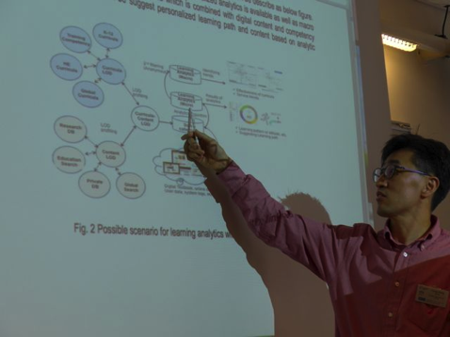
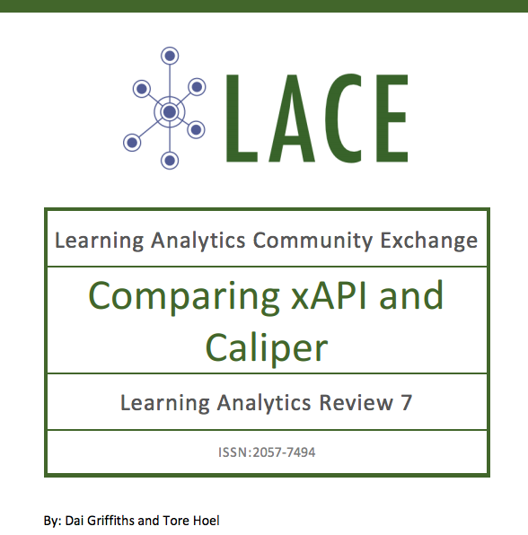
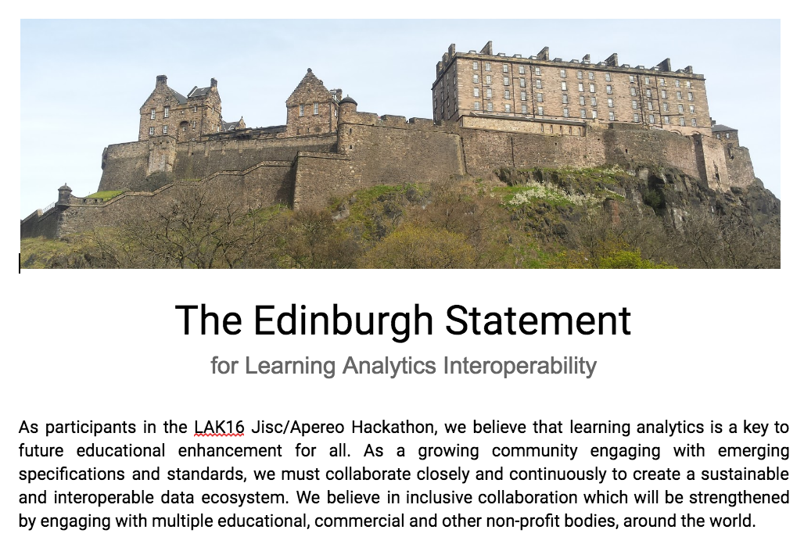
WP7: Data Interoperability
Big Picture Data Inter-operability for LA (D7.3, D7.4)
New LACE Review
Cooperation with various organizations (xAPI, IMS, ISO, Apereo)
Edinburgh Statement
Invited speaker for ISO meetings in Asia

Slide 11
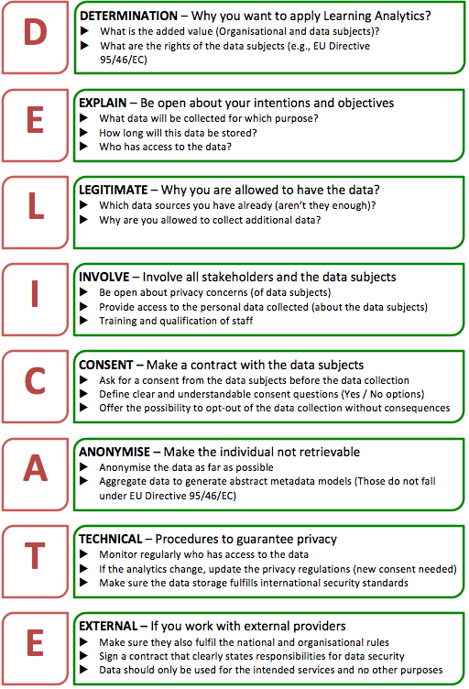
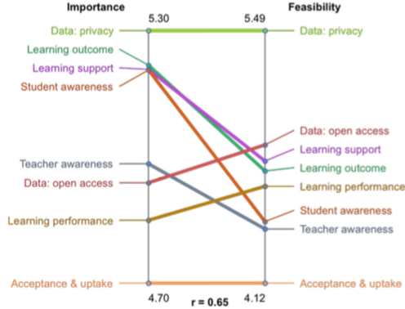
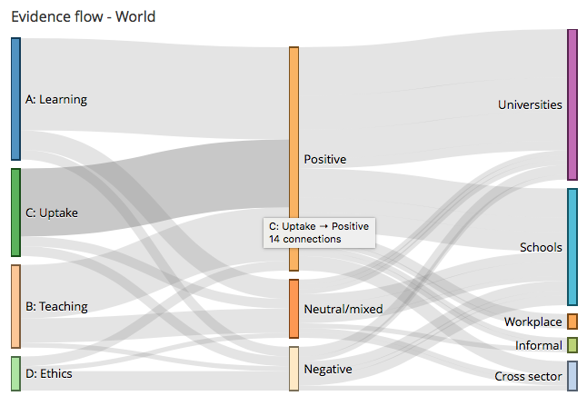
Exploitation & Sustainability
D1.4 Exit Action Plan
Identified 7 main outcomes to sustain after the project lifecycle and that went into the proposal for a SIG LACE @ SoLAR
Evaluation Framework for Learning Analytics (EFLA)
Evidence Hub
Learning Analytics Reviews
The LACE Voice (Website, LinkedIn, Twitter, YouTube, Slideshare)
LACE Community (80 Associate partners, 600 Policymakers)
Expert Studies (Ethics & Privacy, Interoperability, Vision Future)
Stakeholder interviews (51 interviews)
Project LACE (Learning Analytics Community EXCHANGE)
SIG LACE (Learning Analytics Community EUROPE) @ SoLAR
For Individuals become a member:
Receive latest news & Trend Reports
Exclusive invitation to community events
No fee involved
For LA Projects become a BOARD member
Use the SIG LACE @ SoLAR as Exploitation point for your sustainability strategy
Depending on Exploitation activites fee of 1000 – 2000 EUR
Become Board Member of SIG LACE @ SoLAR

Slide 12


www.laceproject.eu
@laceproject
“LACE Project overview” by Hendrik Drachsler, OUNL was presented at the WAPLA Workshop in Lyon on 16st September, 2016.
hendrik.drachsler@ou.nl
This work was undertaken as part of the LACE Project, supported by the European Commission Seventh Framework Programme, grant 619424.

