Slide 1
mining trace data to reveal students' learning strategies and strategy-based student profiles
Jelena Jovanovic
University of Belgrade, Serbia
jeljov@gmail.com ; http://jelenajovanovic.net
Joint work with
Dragan Gašević, Abelardo Pardo, Shane Dawson, Negin Mirriahi

Slide 2
Background / Motivation

Slide 3
Educational benefits of active learning approaches are now well established
Freeman, S., et al. (2014). Active learning increases student performance in science, engineering, and mathematics. Proceedings of the National Academy of Sciences, 201319030.
Notes:
The need for active learning techniques has been recognized as especially important and beneficial in STEM disciplines
The impact of active learning on educational outcomes is found to be both large and consistent. Freeman et al (2014) examined two outcome measures: the failure rate in courses and the performance on tests. The average failure rate decreased from 34% with traditional lecturing to 22% with active learning, whereas performance on identical or comparable tests increased by nearly half the SD of the test scores (an effect size of 0.47). These benefits of active learning were consistent across all of the different STEM disciplines and different levels of courses (introductory, advanced, majors, and nonmajors) and across different experimental methodologies.
The highest impacts were observed in studies where a larger fraction of the class time was devoted to active learning.

Slide 4
Students engagement in active learning
often does not occur spontaneously
Course design needs to prompt
active engagement and higher order thinking
Bryson, C., & Hand, L. (2007). The role of engagement in inspiring teaching and learning. Innovations in Education and Teaching International, 44(4), 349–362.

Slide 5
Flipped Learning (FL)
an active learning design that engages students both before and during ‘lectures’

Slide 6
Research offers increasing
(indirect) evidence for the benefits of FL
increased student satisfaction and
higher course performance
O’Flaherty, J., & Phillips, C. (2015). The use of flipped classrooms in higher education: A scoping review. The Internet and Higher Education, 25, 85–95.
Notes:
28 studies examined in the scoping review

Slide 7
Still open questions:
How students approach and manage this new learning design?
How they regulate their learning in FL settings?
Notes:
Considering that the FC model fosters student ownership of learning and is quite different from the ‘traditional’ lecture model, it is interesting and important to gain some insight in how students approach and ‘cope’ with this new learning context, and how they organize their learning.

Slide 8
Learners tend to choose suboptimal learning tactics and strategies
Winne, P. H., & Jamieson-Noel, D. L. (2003). Self-regulating studying by objectives for learning: Students’ reports compared to a model. Contemporary Educational Psychology, 28 , 259–276.

Slide 9
Learning strategy:
“any thoughts, behaviors, beliefs or emotions that facilitate the acquisition, understanding or later transfer of new knowledge and skills”
Weinstein, C. E., Husman, J., & Dierking, D. R. (2000). Self-regulation interventions with a focus on learning strategies. In P. R. Pintrich & M. Boekaerts (Eds.), Handbook on self-regulation (pp. 727–747). New York: Academic.

Slide 10
Learners are not accurate reporters of how they study
Zhou, M., & Winne, P. H. (2012). Modeling academic achievement by self-reported versus traced goal orientation. Learning and Instruction, 22 , 413–419.
Notes:
One of the primary source of data about student agency and self-regulation of learning is through the self-reported data. However, self-reports are not the most reliable instrumentation, given the biases and inaccuracy associated with understanding metacognition. To overcome some of the drawbacks of self-reported measures, the use of more objective measures – such
as students’ trace data – is often recommended

Slide 11
Compared to self-reports, learning traces
offer more objective insight into students’ learning behavior, and
allow for data collection in an unobtrusive way
Winne, P. H. (2013). Learning Strategies, Study Skills, and Self-Regulated Learning in Postsecondary Education. In M. B. Paulsen (Ed.), Higher Education: Handbook of Theory and Research (pp. 377–403). Springer Netherlands.

Slide 12
Students learning strategies are
latent constructs
that can only be estimated
using the available observations (trace data)
Joeng, H., Biswas, G., Johnson, J. & Howard, L. (2010). Analysis of productive learning behaviors in a structured inquiry cycle using hidden Markov models. Proceedings of the 3rd Int. Conf. on Educational Data Mining (EDM 2010), Pittsburgh, PA.
Notes:
Previous studies exploring students’ learning tactics and strategies primarily relied on questionnaires and think-aloud protocols; these have several deficiencies (Winne, 2013) that can be overcome by grounding analysis on the trace data

Slide 13
Research questions

Slide 14
Research question 1
What learning strategies do students adopt when preparing for F2F sessions in a FL setting?
Preparation activities are essential for students’ effective participation in F2F sessions

Slide 15
Research question 2
Do students’ learning strategies
associated with class preparation activities
change over a FL course?

Slide 16
Research question 3
Is there a significant difference in the course performance among the student groups who applied different strategies when preparing for F2F sessions in a FL setting?

Slide 17
Method

Slide 18
Context
First year engineering course in Computer systems at an Australian higher education institution
Length: 13 weeks
Enrolment: ~300 students
Students with limited, if any, experience with FL

Slide 19
Context
Elements of the FL design:
preparation activities to be completed before the lecture (F2F session with the teacher)
redesigned lecture, framed as an active learning session requiring students’ preparation

Slide 20
Context
Preparation activities:
Short videos followed by multiple choice questions (MCQs) providing formative feedback
Lecture materials (documents) with embedded MCQs offering formative feedback
Problem sequences serving as summative assessment

Slide 21
Analysis
Exploratory sequence analyses
(sequence = encoded learning session data)
[1] (CONTENT_ACCESS,3)
[2] (EXE_IN,3)-(EXE_CO,1)-(EXE_IN,1)-(EXE_CO,1)-(EXE_IN,2)
[3] (CONTENT_ACCESS,3)-(EXE_IN,4)
[4] (MC_EVAL,4)
[5] (EXE_IN,5)-(EXE_CO,1)-(EXE_IN,3)-(EXE_CO,1)-(EXE_IN,2)- (EXE_CO,1)-(EXE_IN,9)-(EXE_CO,4)-(EXE_IN,4)-(EXE_CO,1)- (EXE_IN,2)-(EXE_CO,2)-(EXE_IN,3)-(EXE_CO,3)-(EXE_IN,1)- (EXE_CO,2)-(EXE_IN,1)
[6] (CONTENT_ACCESS,2)
Gabadinho, A., Ritschard, G., Müller, N.S. & Studer, M. (2011). Analyzing and visualizing state sequences in R with TraMineR, Journal of Statistical Software, 40(4), 1-37.

Slide 22
Analysis
Agglomerative hierarchical clustering of
learning sequences – to detect students’ learning strategies
students – to identify student groups (profiles)

Slide 23
Results

Slide 24
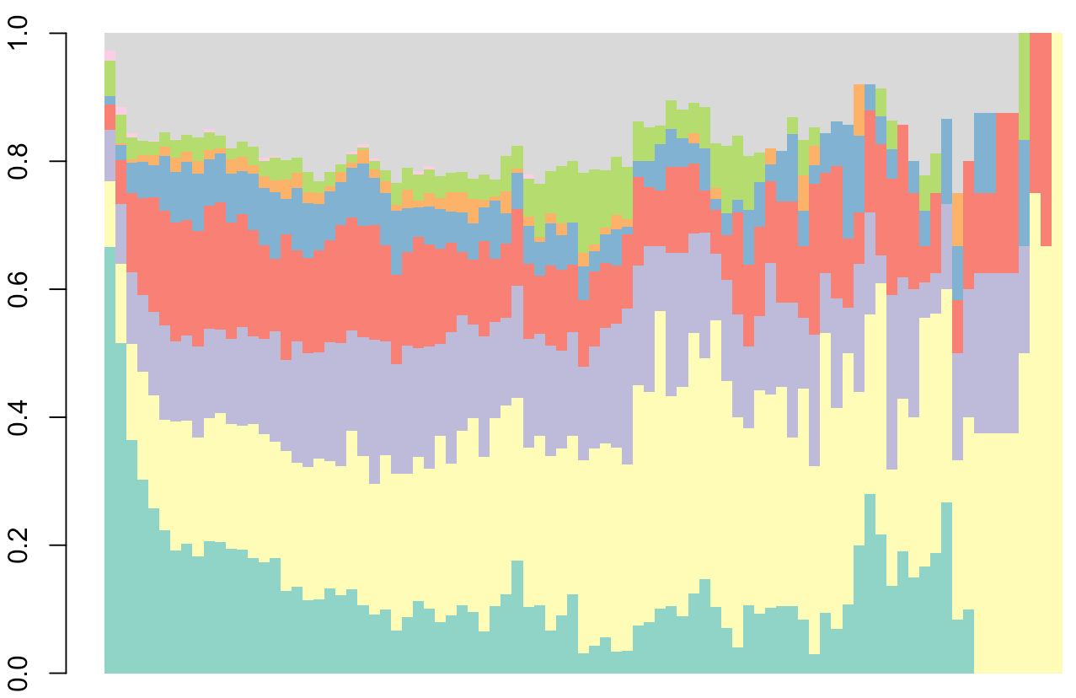
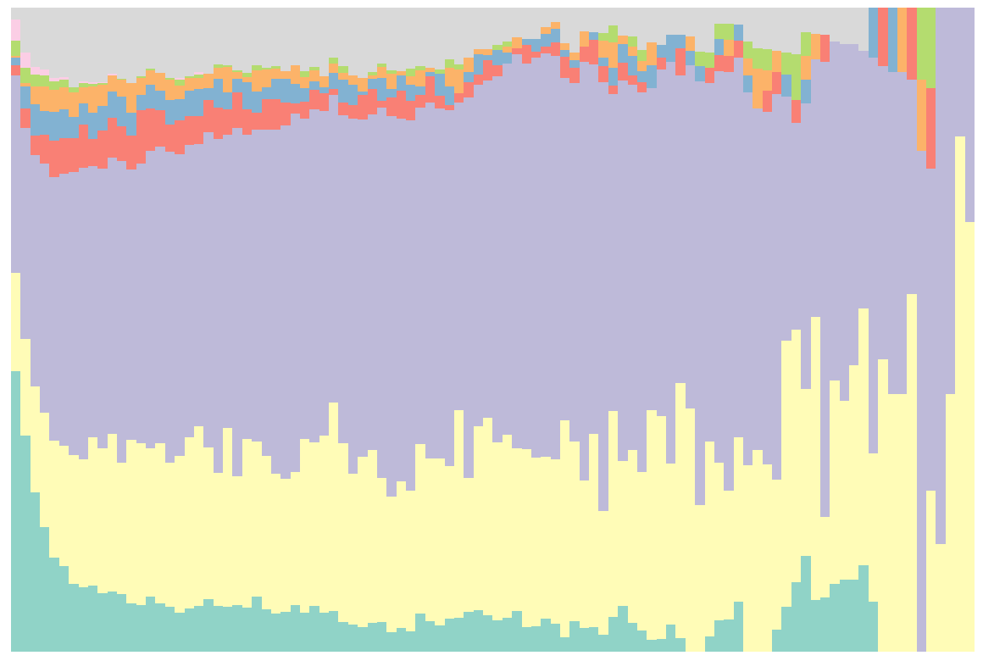
Exploratory sequence analyses
Students with exam scores > 90th perc.
(N students=15 ; N sessions=786 )
Students with exam scores < 25th perc.
(N students=31; N sessions=684 )
Notes:
The X axis should represent the time dimension, but in this particular context – when a sequence corresponds to a learning session – there is no real time dimension. Each session, and consequently, each sequence is considered as a ‘string’ of consecutive learning actions, the actual time when those actions took place is irrelevant. So, the X axis shows the time-ordered actions (within sequences), but does not attach particular time points to those actions; that’s why I removed the points on the X axis.
The reason for choosing students with scores bellow the 25th percentile – and not those with score below the 10th percentile as is the case with top performing students – is to have a comparable number of learning sequences. Students with scores below the 10th percentile produced just 120 sequences (in comparison to 785 of top performers)

Slide 25
Clustering of learning sequences
(N=11,317)
Notes:
The distance measure used is optimal matching, which generates edit distances that are the minimal cost, in terms of insertions, deletions and substitutions, for transforming one sequence into another – in essence, it is the Levenshtein distance

Slide 26
Student clustering based on sequence clusters
Clustering of learning sequences produced, for each student 4 variables, seq.clust_{i}, i=1:4
where seq.clust_{i} has as its value the number of student’s sequences in cluster i
These 4 variables + variable representing the overall level of engagement (seq.total) were used to cluster the students (N=290), again, using hierarchical clustering

Slide 27
Student group profiles
All the group pairs, except for the 1-2, 1-3, 2-3 pairs, are significantly different
(even after applying the FDR correction for multiple testing)
in terms of both midterm and final exam scores

Slide 28
Changes in learning strategies

Slide 29
Conclusions

Slide 30
Summary of the results: RQ1
Clustering of learning sequences allows for
detecting patterns that might be considered
manifestations of the strategies students adopted
when preparing for F2F classes

Slide 31
Summary of the results: RQ2
Students tend to change their learning strategies over time, often towards less effective ones (e.g., reading, watching videos)

Slide 32
Summary of the results: RQ3
Students who experimented with different learning strategies had high course performance
Consistent with previous research findings in SRL
Winne, P. H. (2013). Learning Strategies, Study Skills, and Self-Regulated Learning in Postsecondary Education. In M. B. Paulsen (Ed.), Higher Education: Handbook of Theory and Research (pp. 377–403). Springer Netherlands.

Slide 33
How / to whom this might be relevant?
Inform instructors on whether the deployed FL design was effective in sustaining student engagement and preparing them for F2F sessions
Improve students awareness of their learning strategies, and how those strategies compare to the strategies of high performing peers

Slide 34
Limitations
We were able to detect manifestations of learning strategies, but we cannot know:
why students decided to approach a learning task in the given way, or
what learning objectives they set for themselves
what kind of learning motivation drove their actions
Notes:
Regarding motivation: Lust et al (2013) found a connection between i) mastery goal orientation and active tool use, and ii) performance goal orientation and selective tool use.
Lust, G., Elen, J., Clarebout, G., 2013b. Students’ tool-use within a web enhanced course: Explanatory mechanisms of students’ tool-use pattern. Computers in Human Behavior 29 (5), 2013–2021.

Slide 35
Ways forward
Combining trace data with data from other sources (e.g., questionnaires) to better understand the students’ learning behavior

Slide 36
Ways forward
Investigate if / how:
detected strategies can be used for adaptive inclusion of feedback and/or scaffolds to help students improve their learning behavior
visualizations of student’s learning behaviour can be used to inform and facilitate reflection

Slide 37
THANK YOU!
https://commons.wikimedia.org/wiki/File:Thats_all_folks.svg

